Slide 1
Python Modules
© Krishna Nimbalkar

Slide 2
What is a Module?
>> Consider a module to be the same as a code library.
>> A file containing a set of functions you want to include in your application.

Slide 3
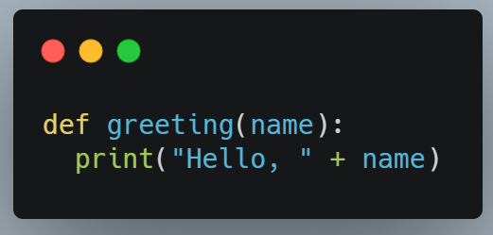
How to Create a Module ?
Step 1: To create a module just save the code you want in a file with the file extension .py
Step 2: Save this code in a file named mymodule.py

Slide 4
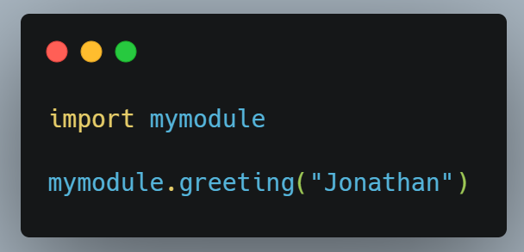
How to Use a Module ?
Stepp 3: We can use the module we just created, by using the import statement:

Slide 5
Variables in Module
The module can contain functions, as already described, but also variables of all types (arrays, dictionaries, objects etc).

Slide 6
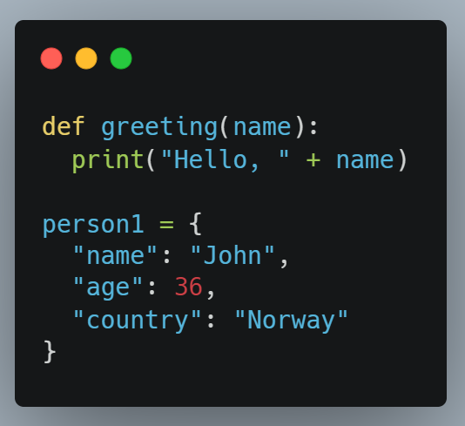
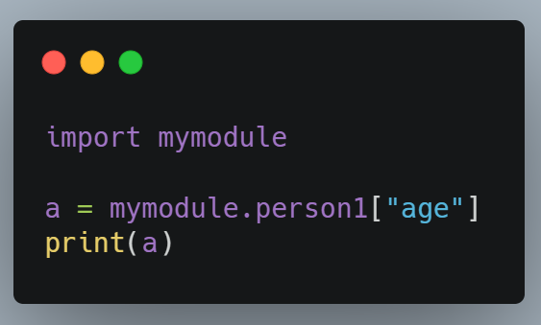
Save this code in the file mymodule.py
Import the module named mymodule, and access the person1 dictionary

Slide 7
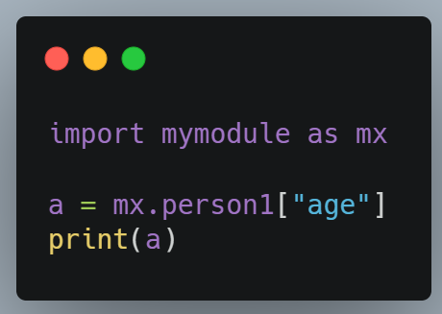
Naming a Module : You can name the module file whatever you like, but it must have the file extension .py
Re-naming a Module You can create an alias when you import a module, by using the as keyword:

Slide 8
Built-in Modules
There are several built-in modules in Python, which you can import whenever you like.
To display a list of all available modules, use the help('modules’) command in the Python console.
You can also use the dir() function to know the names and attributes of a module.

Slide 9
Some Built-in Modules
01
02
03
Python - OS Module
It is possible to automatically perform many operating system tasks. The OS module in Python provides functions for creating and removing a directory (folder), fetching its contents, changing and identifying the current directory, etc.
Python - Sys Module
The sys module provides functions and variables used to manipulate different parts of the Python runtime environment. You will learn some of the important features of this module here.
Python - Random Module
Functions in the random module depend on a pseudo-random number generator function random(), which generates a random float number between 0.0 and 1.0.

Slide 10
Python - OS Module

Slide 11
Python - Sys Module

Slide 12
Python - Random Module

Slide 13
Python - Math Module
27%
70%
52%

Slide 14
Python – Date Module
S | M | T | W | T | F | S
Start
 |  |  |  |  | End

Slide 15
THANKS
Do you have any questions?
Krishna Nimbalkar
kgn272000@gmail.com
+91 7020390678
Please keep this slide for attribution.

